Slide 1
Aario’s Code Style Guide
To help partners, not to restrict them

Slide 2

This guide is based on the Google Code Style Guide and Aario’s personal experience. It’s a guide to PHP, C/C++, Shell, Javascript, Swift, and so on.
The purpose of this guide is to help partners, but not to restrict them.
This guide will not restrict the personal code habits that don’t bother other cooperators.
Code Style Guide Of Google ：
https://github.com/google/styleguide

Slide 3
Principles 技术原则
Done is better than perfect
Micro and Beautiful 小而美
Simple and Transferable 简单可移交
Postel Rule 模块和接口参数要“宽进严出”
Focus on Essential Complexity, and decrease the Accidental Complexity
Postel Rule: https://tools.ietf.org/html/rfc761

Slide 4
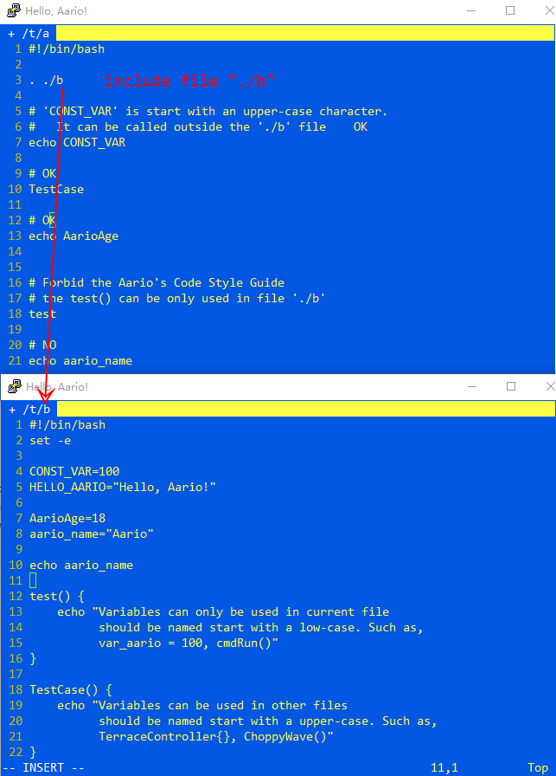
Naming
Variables can only be named start with an alphabet character only.
Constants should be named with upper-case and underline characters only.
Variables can only be used in current file should be named start with a lower-case character. Such as, var_aario = 100, cmdRun()
Variables can be used in other files should be named start with an upper-case character. Such as, TerraceController{}, ChoppyWave(), FirstName = “Aario”

Slide 5

local variables belong to you
You can remove any variable named start with a lower-case character without notifying others.
You can give any name you want to a local variable which should be named start with a lower-case character.
Global Variables Belong To Team
You have to notify the team leader and the manage when you want to remove a variable, a function or a class which is named start with an upper-case character.

Slide 6
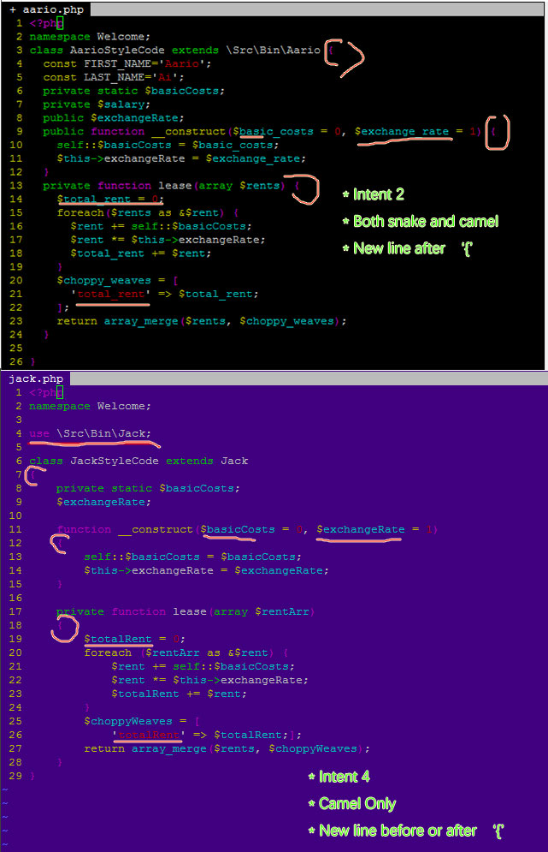

Following the code style of the file you are modifying.
Do not reformat the code style of a file which doesn't belong to you!
You can reformat the code style of a file after transferring the file’s ownership to you.

Slide 7
/**
* Commentary Topic
* This is the content of the commentary.
* Keep align it when break lines * @var --> @field @constant @define variable * @param --> @arg parameter * @param --> value-result * @return --> @returns return of function * @throw throw exception * @todo * @see --> @link @tutorial see the link * @author * @version * @example * @extends --> @derive * @note --> @remind note */
class HelloAario extends Aario {
}
Comment

Slide 8
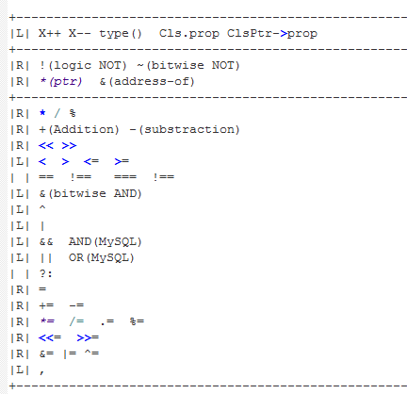
Operator Precedence
PHP Operator Precedence:
http://php.net/manual/en/language.operators.precedence.php
CPP Operator Precedence:
http://en.cppreference.com/w/cpp/language/operator_precedence
C Operator Precedence:
http://en.cppreference.com/w/c/language/operator_precedence

Slide 9
Q&A
There’s a function `getIP()` in file `aario.c` which is included in the file `jack.c` you are coding. Can you use it?
There’s a function `getIP()` in file `aario.c` which is written by Aario. And you are Jack. Can you remove the function `getIP()` in that file?
There’s a variable `int ServerID = 10000` you wrote several days ago in file `jack.c`. Now you don’t need it. What should you do before removing it?
You’re optimizing a file ‘Aario.php’ which belongs to your partner. He indents with 2 spaces and you always indent with 4. Can you re-format ‘Aario.php’? If you really want to reformat it, what should you do?

Slide 10
Thanks, by Aario

